Slide 1
Fantastic Code and How to Run It
It’s not all magic

Slide 2
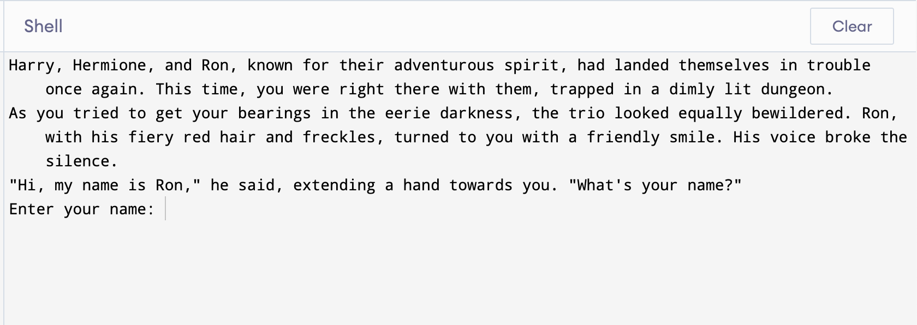
It’s a Game Time!
Notes:
https://www.programiz.com/python-programming/online-compiler/
https://github.com/edvalin/story

Slide 3
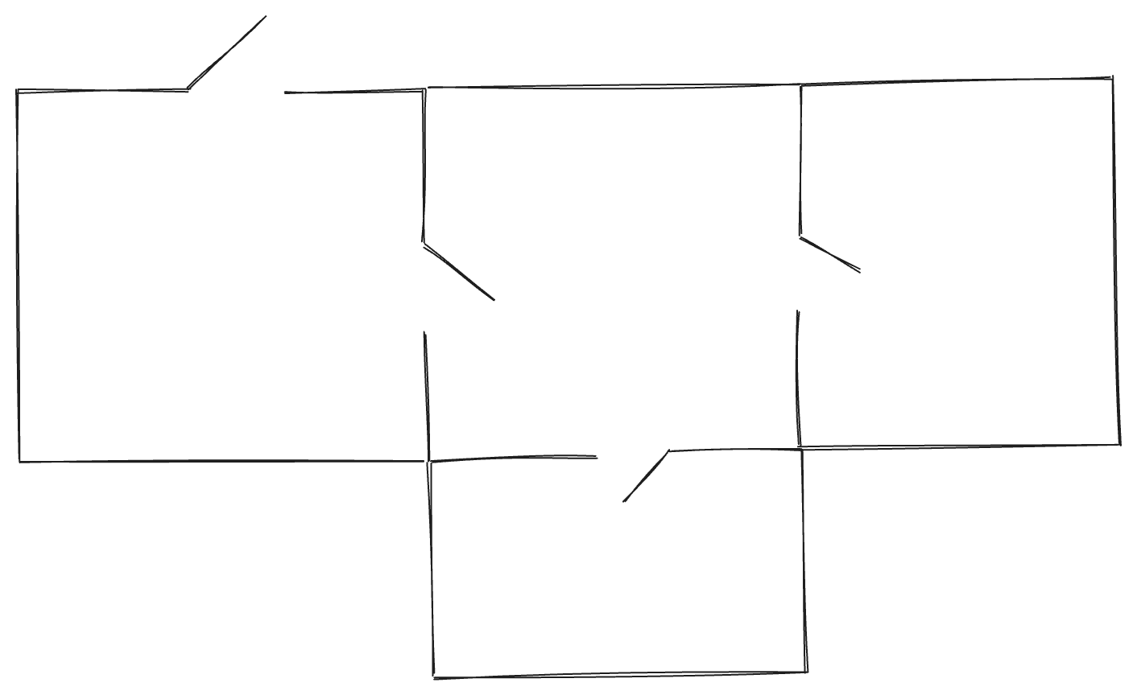
Dungeon

Slide 4
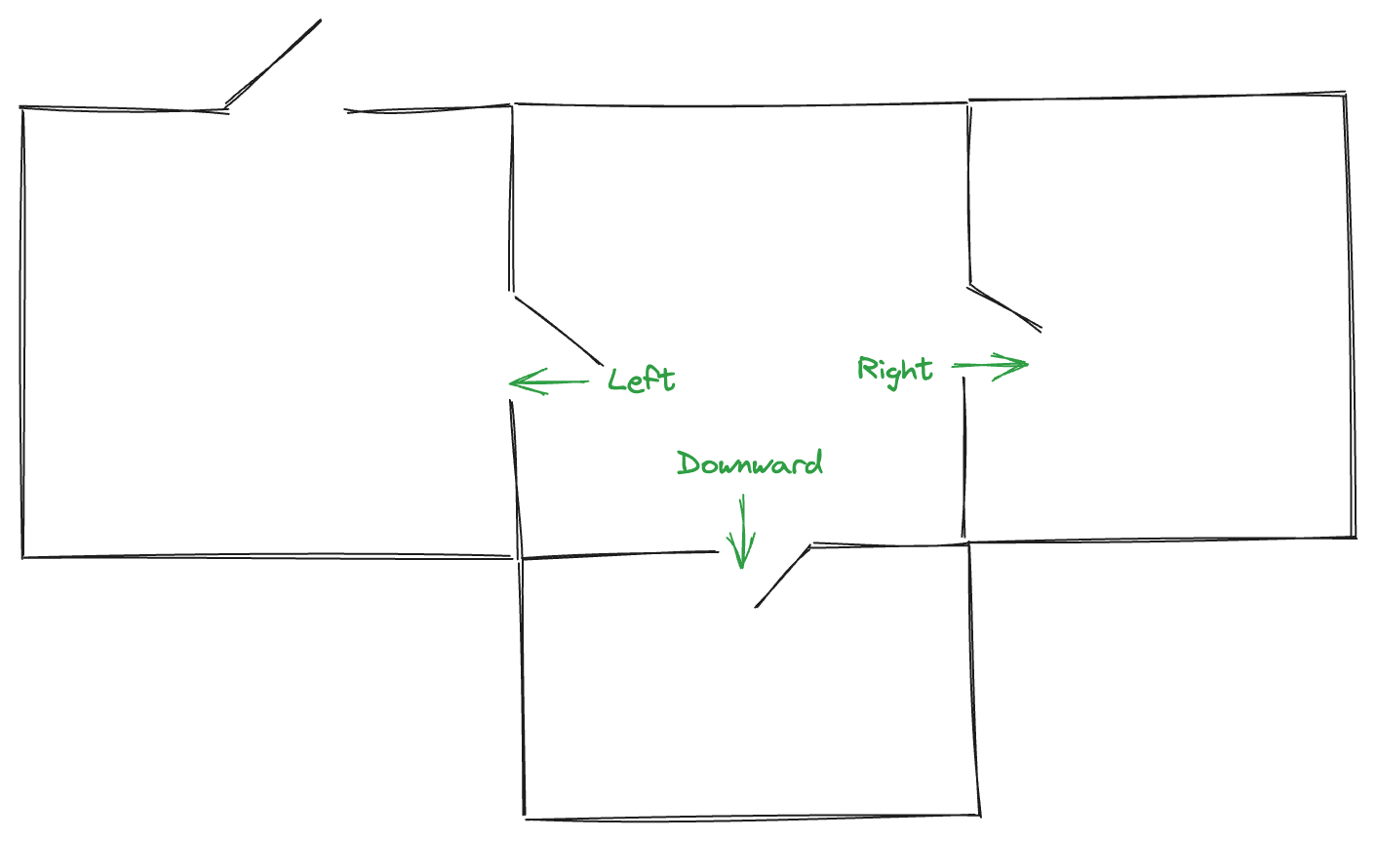
Dungeon

Slide 5
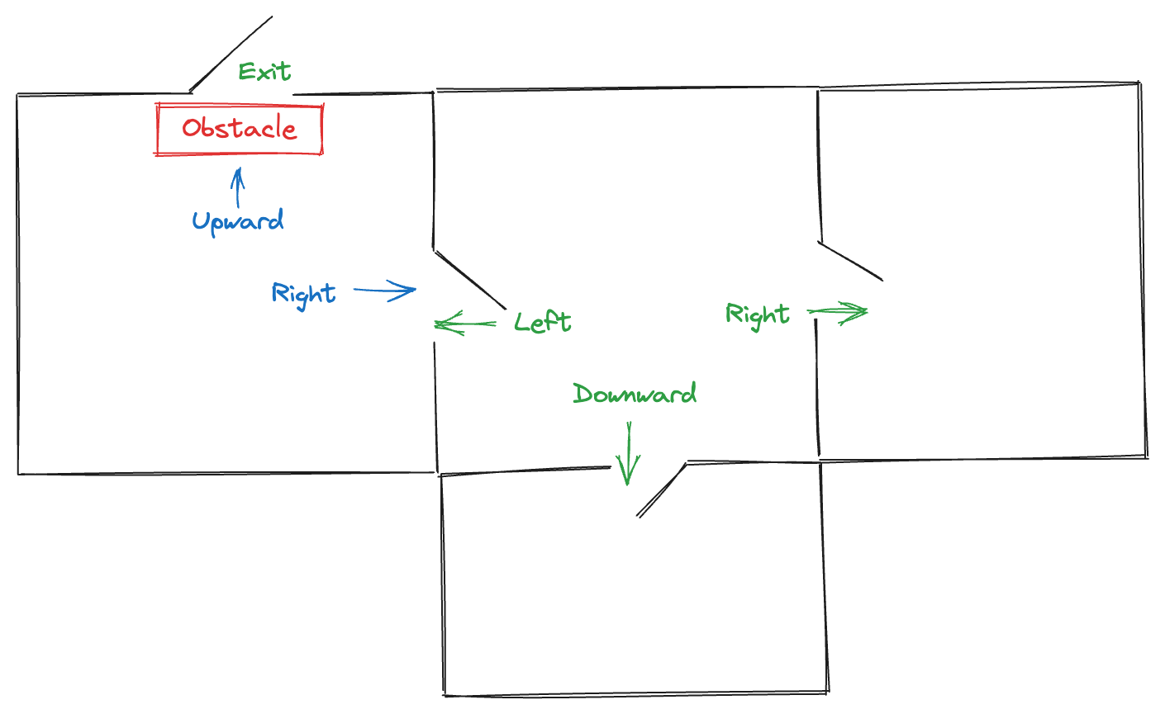
Dungeon

Slide 6
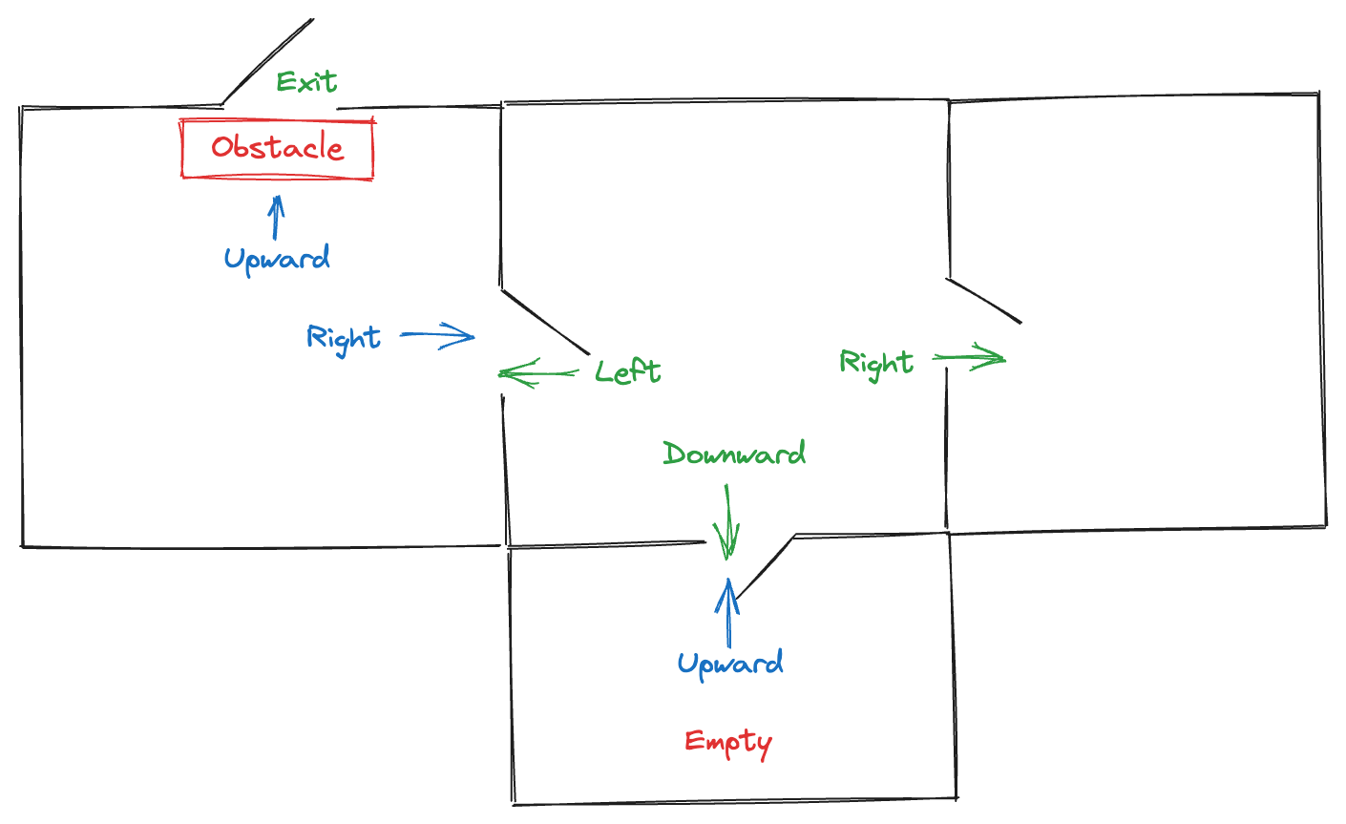
Dungeon

Slide 7
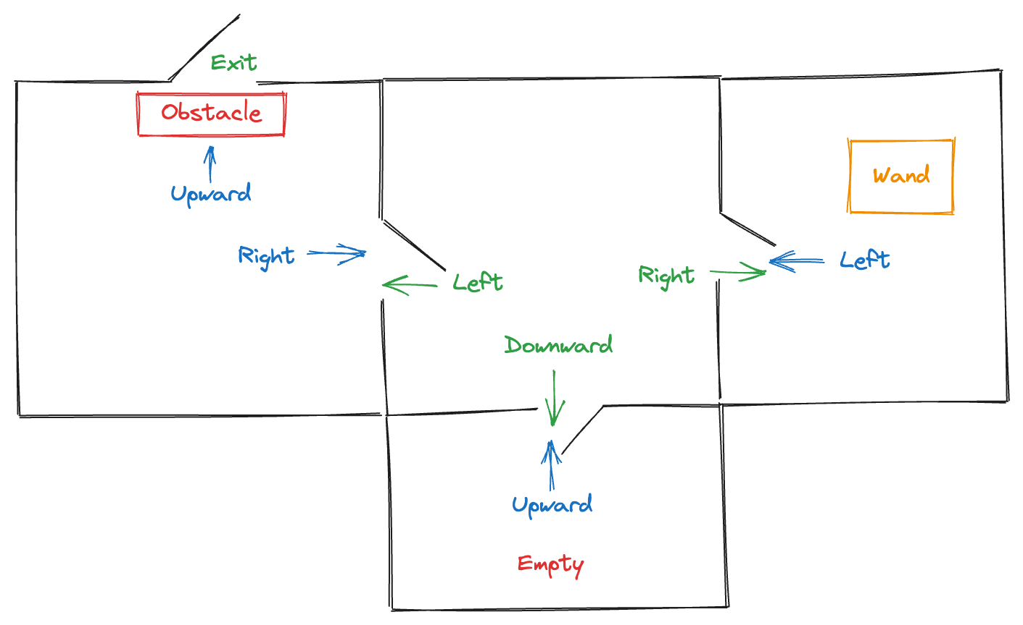
Dungeon

Slide 8
What we need to Implement
Introduction to Dungeon
Ask for players Name
Go to initial room
Ask player to enter next direction
Find Wand
Remove obstacle and escape

Slide 9
What is programing language
There are certain rules and concepts that are similar in every language.
Programming languages are no different
Notes:
Regardless of language every novel follows similar pattern. It consists of chapters, paragraphs, sentences, words and letters. Programming languages are somewhat similar. They all try to create a set of instruction that computer will need to follow. Some are more human readable, some are more capable.
Instructions to computers

Slide 10
Purpose of Programming Languages
Instead of people we communicate with computers
Notes:
Code is human readable
But it is compiled into instructions that computers can understand

Slide 11
How Programing Language Looks Like?
Logic is the key:
If raining today take uber else walk

Slide 12
Why Python?
Easy for beginners to understand
Simple to run

Slide 13
What concepts we will use to create a Dungeon
Variables
Lists
Functions
While loops
If conditional statement
Notes:
Variables – like labels
Lists – collections of some values
Functions – bundles code together
If conditional statement – the condition (if raining take uber)
While loops – or just loops – repeats actions until some condition met (while raining take uber)

Slide 14
Step 1
https://github.com/edvalin/story/blob/main/game_step1.py
Notes:
We are going to write our first line of code
Print is built in Python function that tells computer to print whatever we ask it to the console
Input stops and waits for user to key in something
Function bindles up lines of code so we don’t need to repeat writing same code again and again

Slide 15
Step 2
https://github.com/edvalin/story/blob/main/game_step2.py
Notes:
Introduce conditions

Slide 16
Step 3
https://github.com/edvalin/story/blob/main/game_step3.py

Slide 17
Step 4
https://github.com/edvalin/story/blob/main/game_step4.py

Slide 18
Step 5
https://github.com/edvalin/story/blob/main/game_step5.py

